Slide 1
CORS

Slide 2
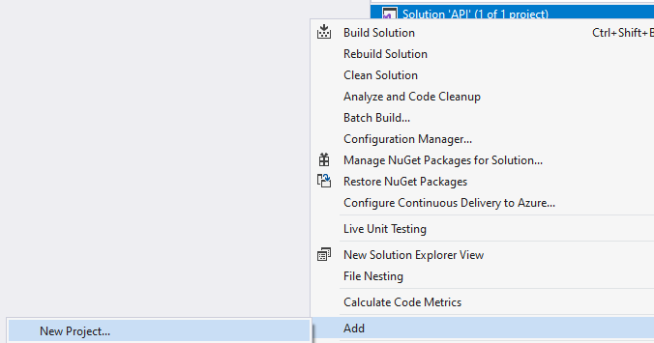
Add new ASP .Net Core MVC project in your current project named Client

Slide 3
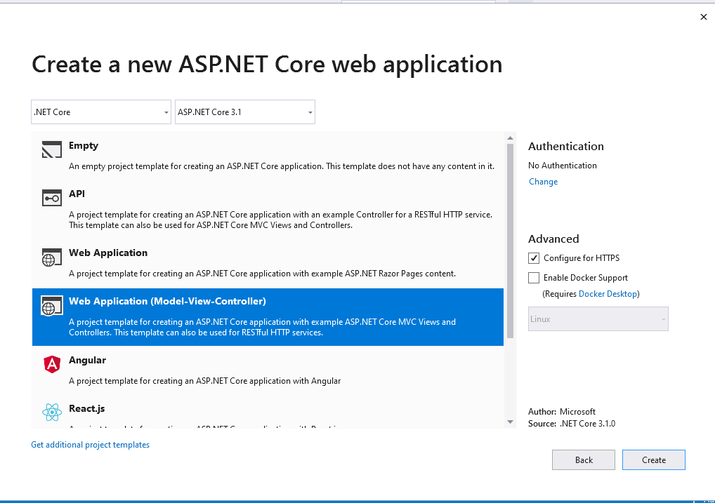

Slide 4

Here’ your solution look like now

Slide 5
Inside the Client project, add new MVC controller. Named by TestCors

Slide 6
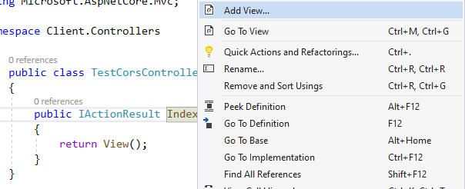
Right click at the Index, click add view

Slide 7
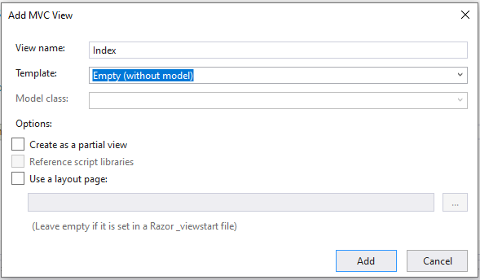
Set like this, click add then

Slide 8
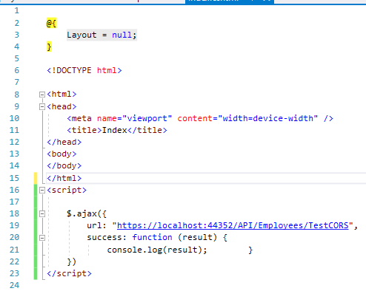
Write code below
You can set the URL freely.

Slide 9

Go back to your API project, go to startup file, add code above inside Configure Service method

Slide 10
And this inside your Configure method

Slide 11
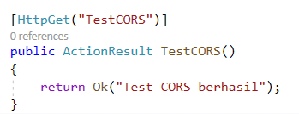
Add the code below
The code from slide 8 (inside the script) will redirect to your API address.
In this case, it will redirect into Employees controller in API project.
To check if your CORS success, add another method like this inside the Employees Controller

Slide 12

Find out the different of AllowAnyOrigin and WithOrigin

Slide 13
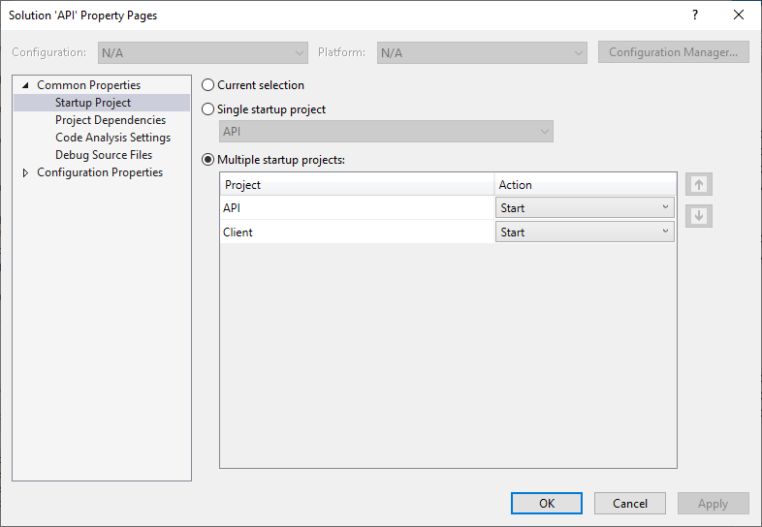
Right click on your solution (above your API project), click properties.
Set like this

Slide 14
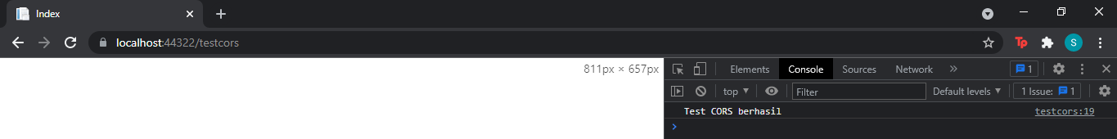
Now run your project. There will be two tabs open, one for API and others for client.
Go to client tab, and open the console. If your CORS success, it will look like this

Slide 15
Reference
https://www.c-sharpcorner.com/article/enabling-cors-in-asp-net-core-api-application/

